Slide 1


INSTITUTE FOR ADVANCED COMPUTING AND SOFTWARE DEVELOPMENT AKURDI, PUNE
“Web Application Deployment with Load Balancing, Automation, and Monitoring using Jenkins, Docker Swarm, and Grafana”
GROUP NO: 01
Mahesh Anerao (233406)
Nilesh Patil (233430)
Mr. Kartik Awari Mr. Rohit Puranik
PROJECT GUIDE CENTRE CO-ORDINATOR

Slide 2
Introduction
In today's dynamic and competitive digital landscape, deploying web applications efficiently, ensuring high availability through load balancing, automating deployment pipelines, and implementing real-time monitoring are paramount. This project report offers a comprehensive account of how Jenkins, Docker Swarm, Grafana, and Nginx were synergistically employed to achieve these objectives.
Jenkins served as the central automation hub, orchestrating the entire deployment pipeline. Docker Swarm was adopted to facilitate container orchestration and, alongside Nginx, ensured load balancing across multiple nodes, underpinning high availability and optimized performance.
Grafana played a pivotal role in real-time monitoring, offering deep insights into key performance metrics, application health, and resource utilization. This comprehensive approach streamlined operations, empowered teams to preemptively address issues, and minimized downtime.

Slide 3
Purpose
The process of DevOps ensures a faster production pipeline. Various strategies and methods can be followed for the continuous delivery of the product. But the time to market cannot be the only reason for all the applications. Some of them have to be stable and should be supported while adding new features and defining the different features to them. The deployment procedure or strategy is not going to be fixed as the design changes. It is very important to have a standard deployment pipeline that supports the versioning of the application with various features and is also supportive of the upgrade. There are multiple problems associated with the deployment that impacts the utility, robustness, correctness and security of the application. The factors that influence the process of deployment are to be controlled for the sake of optimized performance

Slide 4
Requirement
HARDWARE REQUIREMENTS
1. Instance type: t2.micro
2. RAM: minimum 4GB
3. CPU: 2.5 GHZ
SOFTWARE REQUIREMENTS
1. Operating system: Debian
2. Platform: Amazon Web Service
3. CI Platform : Jenkins
4. Monitoring tool: Prometheus (Grafana)

Slide 5
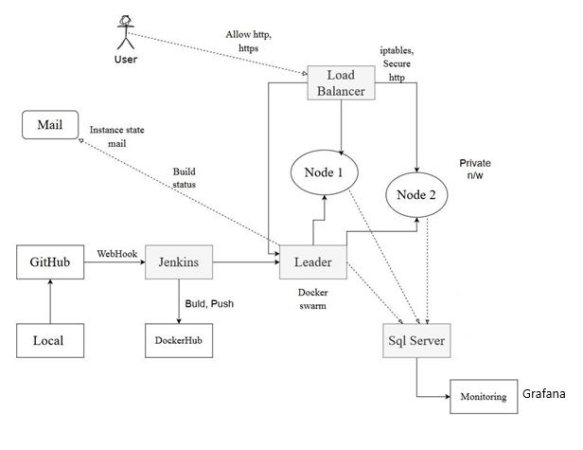
Architecture

Slide 6
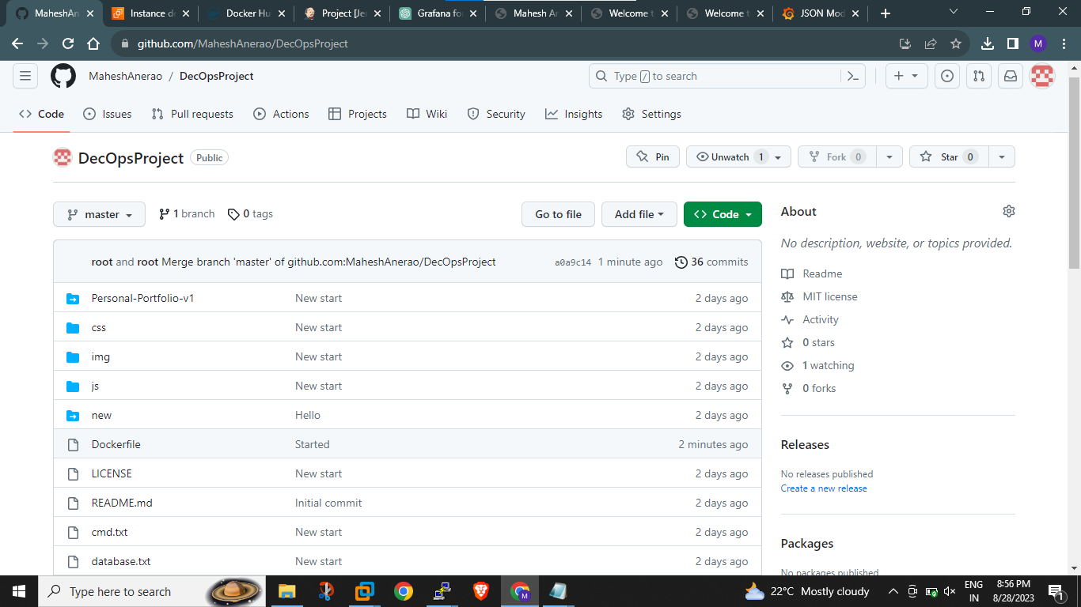
Git (Distributed Version Control System)

Slide 7
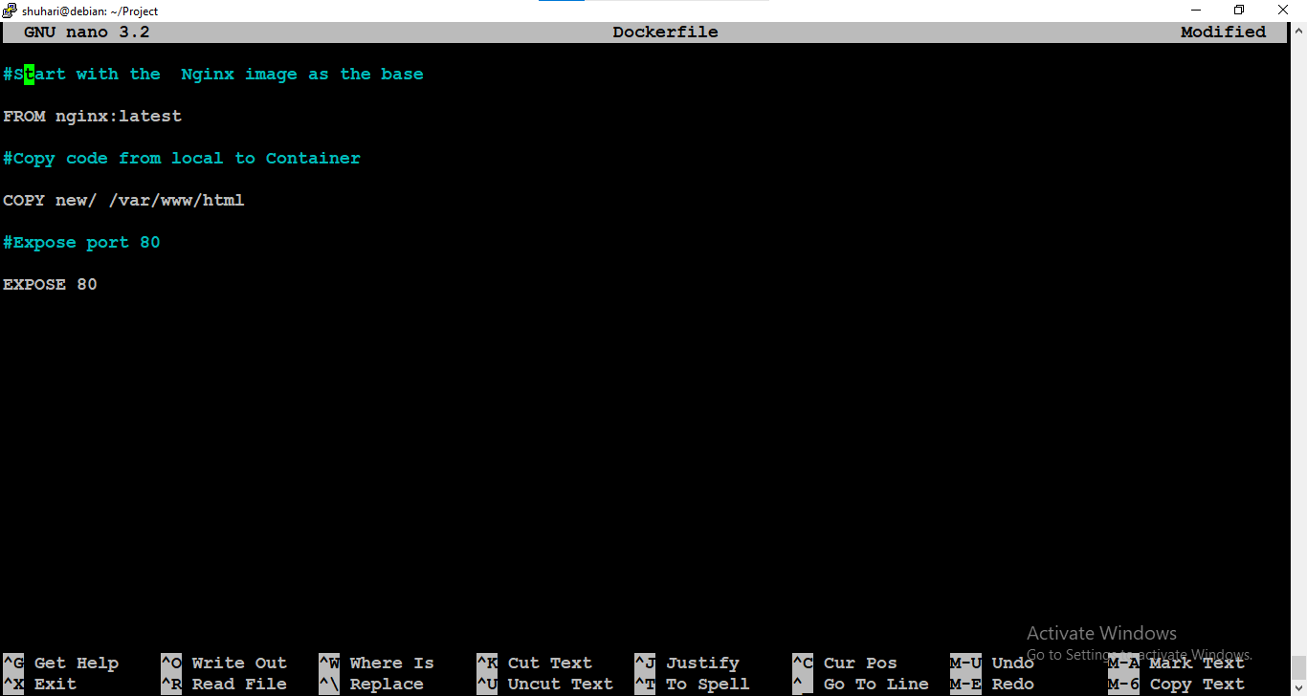
Dockerfile

Slide 8
Project Workflow

Slide 9
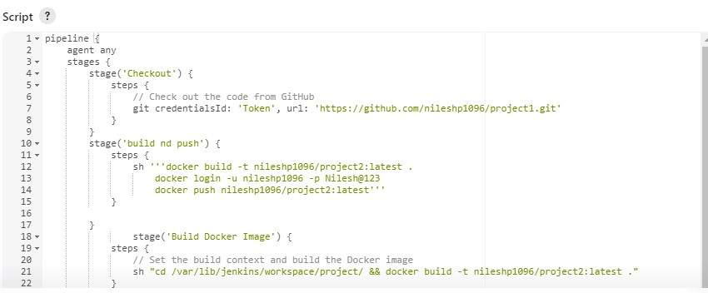
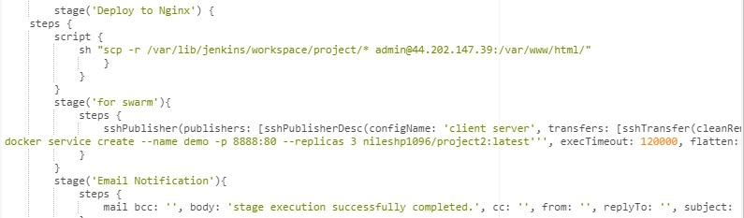
Pipeline

Slide 10
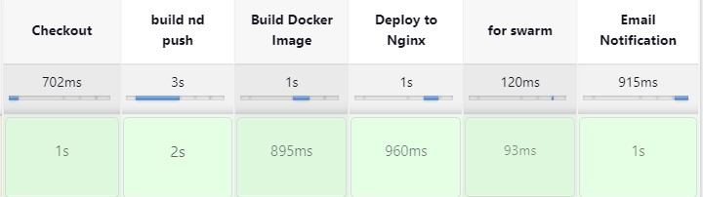
Pipeline Output

Slide 11
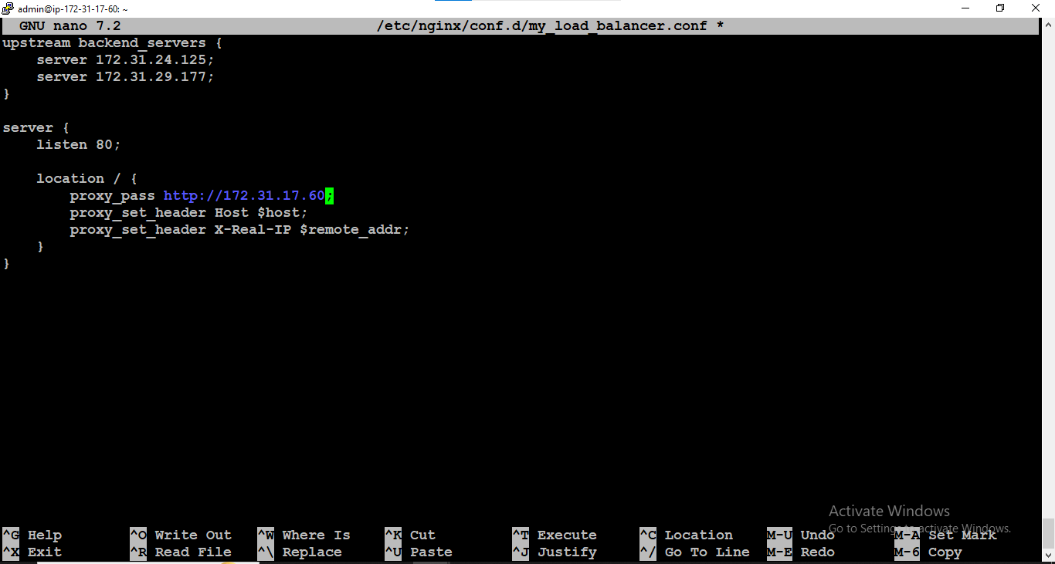
Load Balancer

Slide 12
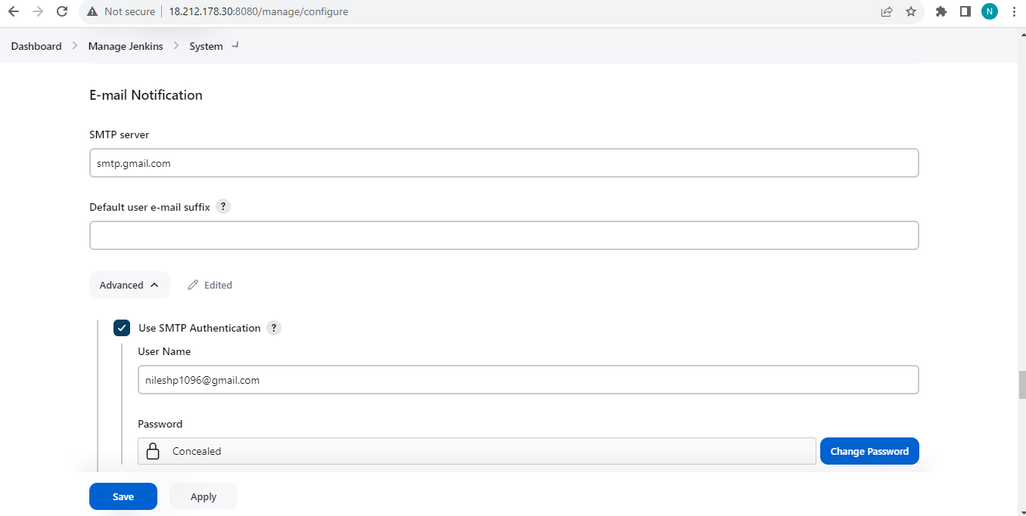
Simple Notification Service

Slide 13
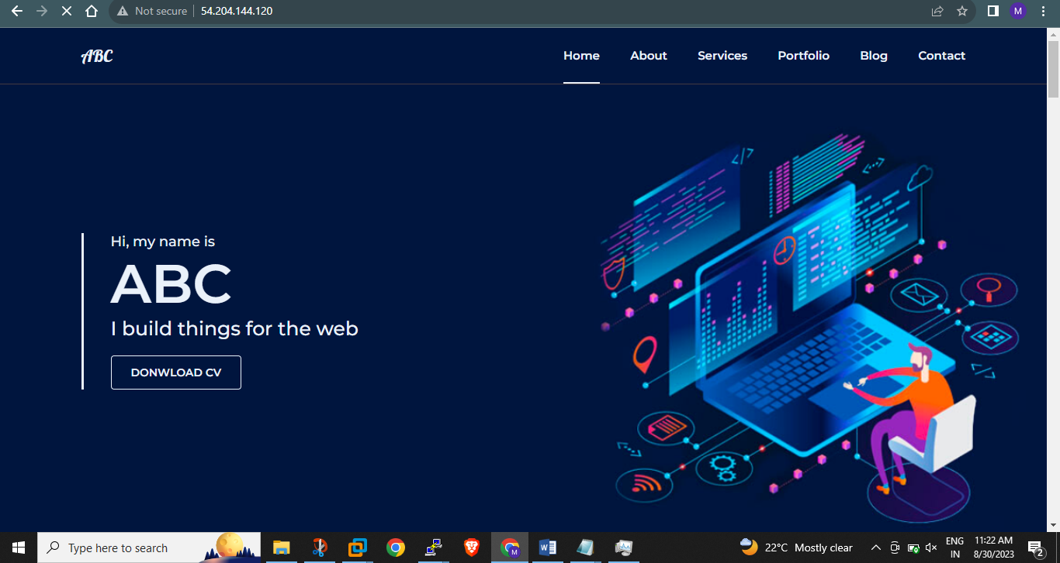
Output

Slide 14
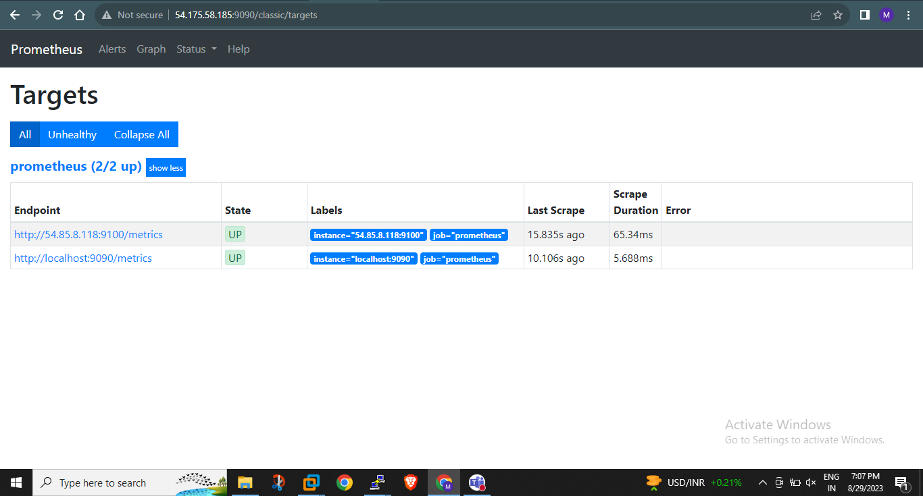
Prometheus Server:

Slide 15
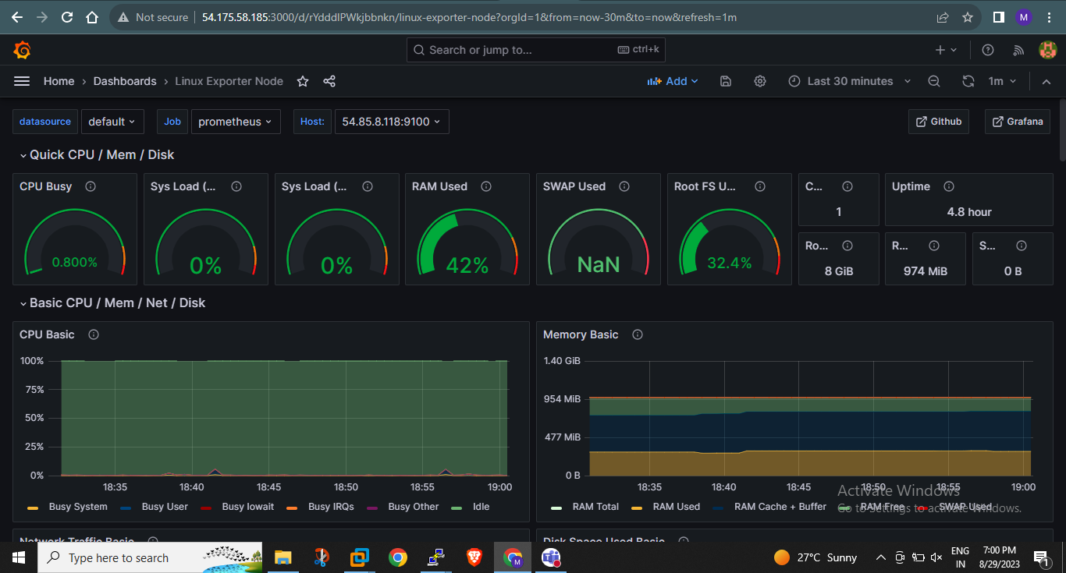
Grafana

Slide 16
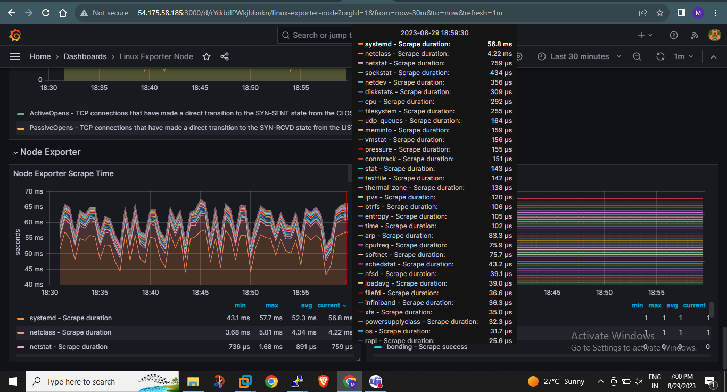
Grafana

Slide 17
Conclusion
The project aims to deploy a web application using Docker Swarm, a container orchestration tool that allows for easy management and scaling of containerized applications. The project will utilize Docker Swarm’s production-ready features
such as load balancing, rolling updates, and service discovery to ensure high
availability and reliability of the web application. The project will involve creating
A Dockerfile to package the application into a container and then deploying it
onto a Swarm cluster. The Swarm cluster will be configured to provide automated failover, load balancing, and horizontal scaling to the application. The goal of the project is to demonstrate the benefits of Docker Swarm for deploying and managing containerized applications in production environments.

Slide 18
THANK YOU

